Slide 1

Processes Management
Operating System Concepts – 8th Edition,
Silberschatz, Galvin and Gagne ©2009

Slide 2
Types of Schedulers
There are three types of schedulers available:
Long Term Scheduler
Short Term Scheduler
Medium Term Scheduler
Operating System Concepts – 8th Edition

Slide 3
Schedulers
Long-term scheduler (or job scheduler) – selects which
processes should be brought into the ready queue
Short-term scheduler (or CPU scheduler) – selects which process should be executed next and allocates CPU
Operating System Concepts – 8th Edition

Slide 4
Schedulers (Cont)
Short-term scheduler is invoked very frequently (milliseconds) ⇒ (must
be fast)
Long-term scheduler is invoked very infrequently (seconds, minutes) ⇒
(may be slow)
The long-term scheduler controls the degree of multiprogramming
Processes can be described as either:
I/O-bound process – spends more time doing I/O than computations, many short CPU bursts
CPU-bound process – spends more time doing computations; few
very long CPU bursts
Operating System Concepts – 8th Edition

Slide 5
Context Switch
When CPU switches to another process, the system must save the state of the old process and load the saved state for the new process via a context switch
Context of a process represented in the PCB
Context-switch time is overhead; the system does no useful work
while switching
Time dependent on hardware support
Operating System Concepts – 8th Edition

Slide 6
Operations on Process
Below we have discussed the two major operation Process Creation and Process
Termination.
Process Creation
Through appropriate system calls, such as fork or spawn, processes may create other processes.
The process which creates other process, is termed the parent of the other process, while the created sub-process is termed its child.
Each process is given an integer identifier, termed as process identifier, or PID.
The parent PID (PPID) is also stored for each process.
On a typical UNIX systems the process scheduler is termed as sched, and is given PID 0. The first thing done by it at system start-up time is to launch init, which gives that process PID 1. Further Init launches all the system daemons and user logins, and becomes the ultimate parent of all other processes.
Operating System Concepts – 8th Edition

Slide 7


Process Termination
By making the exit(system call), typically returning an int, processes may request their own termination. This int is passed along to the parent if it is doing a wait(), and is typically zero on successful completion and some non-zero code in the event of any problem.
Processes may also be terminated by the system for a variety of reasons, including :
The inability of the system to deliver the necessary system resources.
In response to a KILL command or other unhandled process interrupts.
A parent may kill its children if the task assigned to them is no longer needed i.e. if the need of
having a child terminates.
If the parent exits, the system may or may not allow the child to continue without a parent (In UNIX systems, orphaned processes are generally inherited by init, which then proceeds to kill them.)
When a process ends, all of its system resources are freed up, open files flushed and closed, etc. The process termination status and execution times are returned to the parent if the parent is waiting for the child to terminate, or eventually returned to init if the process already became an orphan.
The processes which are trying to terminate but cannot do so because their parent is not waiting for them are termed zombies. These are eventually inherited by init as orphans and killed off.
12
Operating System Concepts – 8th Edition

Slide 8
Process Creation
Parent process create children processes, which, in turn create other
processes, forming a tree of processes
Generally, process identified and managed via a process identifier
(pid)
Resource sharing
Parent and children share all resources
Children share subset of parent’s resources
Parent and child share no resources
Execution
Parent and children execute concurrently
Parent waits until children terminate
Operating System Concepts – 8th Edition

Slide 9
Process Creation (Cont)
Address space
Child duplicate of parent
Child has a program loaded into it
UNIX examples
fork system call creates new process
exec system call used after a fork to replace the process’ memory space with a new program
Operating System Concepts – 8th Edition

Slide 10
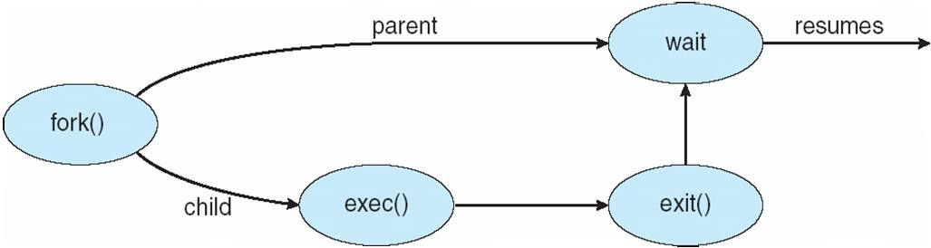
Process Creation
Operating System Concepts – 8th Edition

Slide 11
C Program Forking Separate Process
int main()
{
pid_t pid;
/* fork another process */ pid = fork();
if (pid < 0) { /* error occurred */ fprintf(stderr, "Fork Failed"); exit(-1);
}
else if (pid == 0) { /* child process */
execlp("/bin/ls", "ls", NULL);
}
else { /* parent process */
/* parent will wait for the child to complete */
wait (NULL);
printf ("Child Complete"); exit(0);
}
CDAC Mumbai: Kiran Waghmare
Silberschatz, Galvin and Gagne ©2009
Operating System Concepts – 8th Edition 1.16

Slide 12
Process Termination
Process executes last statement and asks the operating system to
delete it (exit)
Output data from child to parent (via wait)
Process’ resources are deallocated by operating system
Parent may terminate execution of children processes (abort)
Child has exceeded allocated resources
Task assigned to child is no longer required
If parent is exiting
 Some operating system do not allow child to continue if its parent terminates
– All children terminated - cascading termination
Operating System Concepts – 8th Edition

Slide 13
CPU Scheduling
Operating System Concepts – 8th Edition,

Slide 14
CPU Scheduling
Basic Concepts
Scheduling Criteria
Scheduling Algorithms
Thread Scheduling
Multiple-Processor Scheduling
Operating Systems Examples
Algorithm Evaluation
Operating System Concepts – 8th Edition

Slide 15
Objectives
To introduce CPU scheduling, which is the basis for multiprogrammed
operating systems
To describe various CPU-scheduling algorithms
To discuss evaluation criteria for selecting a CPU-scheduling algorithm for a particular system
Operating System Concepts – 8th Edition

Slide 16
Basic Concepts
Maximum CPU utilization obtained with multiprogramming
CPU–I/O Burst Cycle – Process execution consists of a
cycle of CPU execution and I/O wait
CPU burst distribution
Operating System Concepts – 8th Edition

Slide 17
CPU Scheduler
Selects from among the processes in memory that are ready to
execute, and allocates the CPU to one of them
CPU scheduling decisions may take place when a process:
Switches from running to waiting state
Switches from running to ready state
Switches from waiting to ready
Terminates
Scheduling under 1 and 4 is nonpreemptive
All other scheduling is preemptive
Operating System Concepts – 8th Edition

Slide 18
Dispatcher
Dispatcher module gives control of the CPU to the process selected by the short-term scheduler; this involves:
switching context
switching to user mode
jumping to the proper location in the user program to restart that program
Dispatch latency – time it takes for the dispatcher to stop one process and start another running
Operating System Concepts – 8th Edition

Slide 19
Scheduling Criteria
CPU utilization – keep the CPU as busy as possible
Throughput – # of processes that complete their execution
per time unit
Turnaround time – amount of time to execute a particular process
Waiting time – amount of time a process has been waiting
in the ready queue
Response time – amount of time it takes from when a request was submitted until the first response is produced, not output (for time-sharing environment)
Operating System Concepts – 8th Edition

Slide 20
Problems with FCFS Scheduling
Below we have a few shortcomings or problems with the FCFS scheduling algorithm:
It is Non Pre-emptive algorithm, which means the process priority doesn't matter.If a process with very least priority is being executed, more like daily routine
backup process, which takes more time, and all of a sudden some other high priority
process arrives, like interrupt to avoid system crash, the high priority process will have to wait, and hence in this case, the system will crash, just because of improper process scheduling.
Not optimal Average Waiting Time.
Resources utilization in parallel is not possible, which leads to Convoy Effect, and hence poor resource(CPU, I/O etc) utilization.
What is Convoy Effect?
Convoy Effect is a situation where many processes, who need to use a resource for short time are blocked by one process holding that resource for a long time.
This essentially leads to poort utilization of resources and hence poor performance.
Operating System Concepts – 8th Edition

Slide 21
Here we have simple formulae for calculating various times for given processes:
Completion Time: Time taken for the execution to complete, starting from arrival time.
Turn Around Time: Time taken to complete after arrival. In simple words, it
is the difference between the Completion time and the Arrival time.
Waiting Time: Total time the process has to wait before it's execution begins. It is the difference between the Turn Around time and the Burst time of the process.
For the program above, we have considered the arrival time to be 0 for all the processes, try to implement a program with variable arrival times.
Operating System Concepts – 8th Edition

Slide 22
Shortest-Job-First (SJF) Scheduling
Associate with each process the length of its next CPU burst. Use these
lengths to schedule the process with the shortest time
SJF is optimal – gives minimum average waiting time for a given set of processes
The difficulty is knowing the length of the next CPU request
Operating System Concepts – 8th Edition

Slide 23
Shortest Job First(SJF) Scheduling
Shortest Job First scheduling works on the process with the shortest burst time or duration first.
This is the best approach to minimize waiting time.
This is used in Batch Systems.
It is of two types:
Non Pre-emptive
Pre-emptive
To successfully implement it, the burst time/duration time of the processes should be known to the processor in advance, which is practically not feasible all the time.
This scheduling algorithm is optimal if all the jobs/processes are available at the same time. (either Arrival time is 0 for all, or Arrival time is same for all)
CDAC Mumbai: Kiran Waghmare
1.20Operating System Concepts – 8th Edition

Slide 24
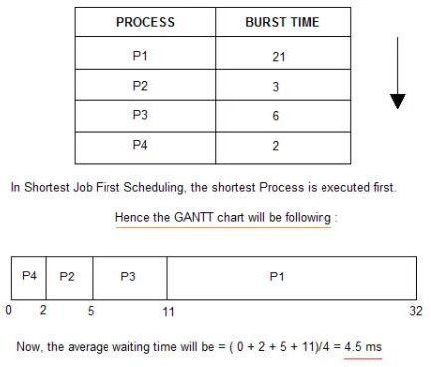
Non Pre-emptive Shortest Job First
Consider the below processes available in the ready queue for
execution, with arrival time as 0 for all and given burst times.
Operating System Concepts – 8th Edition

Slide 25
Problem with Non Pre-emptive SJF
If the arrival time for processes are different, which means all the processes are not available in the ready queue at time 0, and some jobs arrive after some time, in such situation, sometimes process with short burst time have to wait for the current process's execution to finish, because in Non Pre-emptive SJF, on arrival of a process with short duration, the existing job/process's execution is not halted/stopped to execute the short job first.
This leads to the problem of Starvation, where a shorter process has to wait for a long time until the current longer process gets executed. This happens if shorter jobs keep coming, but this can be solved using the concept of aging.
Operating System Concepts – 8th Edition

Slide 26
Priority Scheduling
A priority number (integer) is associated with each process
The CPU is allocated to the process with the highest priority (smallest
integer ≡ highest priority)
Preemptive
nonpreemptive
SJF is a priority scheduling where priority is the predicted next CPU burst time
Problem ≡ Starvation – low priority processes may never execute
Solution ≡ Aging – as time progresses increase the priority of the process
Operating System Concepts – 8th Edition

Slide 27
Priority CPU Scheduling
In this tutorial we will understand the priority scheduling algorithm, how it works and its advantages and disadvantages.
In the Shortest Job First scheduling algorithm, the priority of a process is generally the inverse of the CPU burst time, i.e. the larger the burst time the lower is the priority of that process.
In case of priority scheduling the priority is not always set as the inverse of the CPU burst time, rather it can be internally or externally set, but yes the scheduling is done on the basis of priority of the process where the process which is most urgent is processed first, followed by the ones with lesser priority in order.
Processes with same priority are executed in FCFS manner.
The priority of process, when internally defined, can be decided based on memory requirements, time limits ,number of open files, ratio of I/O burst to CPU burst etc.
Whereas, external priorities are set based on criteria outside the operating system, like the importance of the process, funds paid for the computer resource use, makrte factor etc.
Operating System Concepts – 8th Edition

Slide 28
Types of Priority Scheduling Algorithm
Priority scheduling can be of two types:
Preemptive Priority Scheduling: If the new process arrived at the ready queue has a higher priority than the currently running process, the CPU is preempted, which means the processing of the current process is stoped and the incoming new process with higher priority gets the CPU for its execution.
Non-Preemptive Priority Scheduling: In case of non-preemptive priority scheduling algorithm if a new process arrives with a higher priority than the current running process, the incoming process is put at the head of the ready queue, which means after the execution of the current process it will be processed.
Operating System Concepts – 8th Edition

Slide 29
Round Robin Scheduling
Round Robin(RR) scheduling algorithm is mainly designed for time- sharing systems. This algorithm is similar to FCFS scheduling, but in Round Robin(RR) scheduling, preemption is added which enables the system to switch between processes.
A fixed time is allotted to each process, called a quantum, for execution.
Once a process is executed for the given time period that process is
preempted and another process executes for the given time period.
Context switching is used to save states of preempted processes.
This algorithm is simple and easy to implement and the most important is thing is this algorithm is starvation-free as all processes get a fair share of CPU.
It is important to note here that the length of time quantum is generally from 10 to 100 milliseconds in length.
Operating System Concepts – 8th Edition

Slide 30
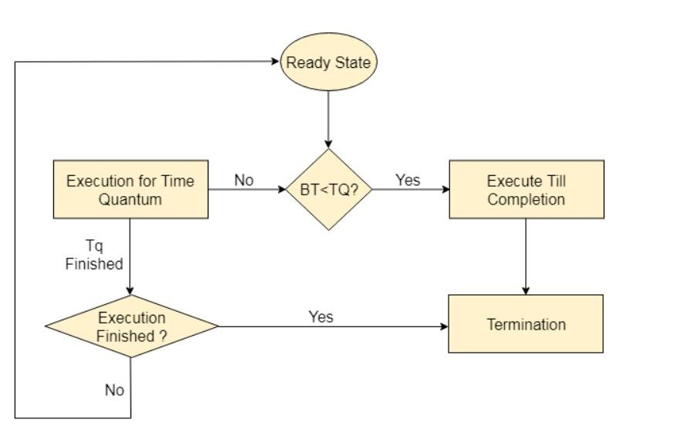
Operating System Concepts – 8th Edition

Slide 31
1. Round Robin Scheduling alg^{f}oºr^{ll}itºh^{w}m^{s:}resides under the category of
Preemptive Algorithms.
Some important characteristics of the Round Robin(RR) Algorithm are as
This algorithm is one of the oldest, easiest, and fairest algorithm.
This Algorithm is a real-time algorithm because it responds to the event within a specific time limit.
In this algorithm, the time slice should be the minimum that is assigned to a specific task that needs to be processed. Though it may vary for different operating systems.
This is a hybrid model and is clock-driven in nature.
This is a widely used scheduling method in the traditional operating system.
Operating System Concepts – 8th Edition

Slide 32
Advantages of Round Robin Scheduling Algorithm
Some advantages of the Round Robin scheduling algorithm are as follows:
While performing this scheduling algorithm, a particular time quantum is
allocated to different jobs.
In terms of average response time, this algorithm gives the best performance.
With the help of this algorithm, all the jobs get a fair allocation of CPU.
In this algorithm, there are no issues of starvation or convoy effect.
This algorithm deals with all processes without any priority.
This algorithm is cyclic in nature.
In this, the newly created process is added to the end of the ready queue.
Also, in this, a round-robin scheduler generally employs time-sharing which means providing each job a time slot or quantum.
In this scheduling algorithm, each process gets a chance to reschedule after a
particular quantum time.
Operating System Concepts – 8th Edition

Slide 33
Disadvantages of Round Robin Scheduling
Algorithm
Some disadvantages of the Round Robin scheduling algorithm are as follows:
This algorithm spends more time on context switches.
For small quantum, it is time-consuming scheduling.
This algorithm offers a larger waiting time and response time.
In this, there is low throughput.
If time quantum is less for scheduling then its Gantt chart seems to be too big.
Operating System Concepts – 8th Edition

Slide 34
Some Points to Remember
1.Decreasing value of Time quantum
With the decreasing value of time quantum
The number of context switches increases.
The Response Time decreases
Chances of starvation decrease in this case.
For the smaller value of time quantum, it becomes better in terms of response time.
2.Increasing value of Time quantum
With the increasing value of time quantum
The number of context switch decreases
The Response Time increases
Chances of starvation increases in this case.
For the higher value of time quantum, it becomes better in terms of the number of the context
switches.
3. If the value of time quantum is increasing then Round Robin Scheduling tends to become FCFS Scheduling.
4.In this case, when the value of time quantum tends to infinity then the Round Robin Scheduling becomes FCFS Scheduling.
5. Thus the performance of Round Robin scheduling mainly depends on the value of the time
quantum.
6.And the value of the time quantum should be such that it is neither too big nor too small.
Operating System Concepts – 8th Edition

Slide 35
Round Robin (RR)
Each process gets a small unit of CPU time (time quantum), usually 10-100 milliseconds. After this time has elapsed, the process is preempted and added to the end of the ready queue.
If there are n processes in the ready queue and the time quantum is q, then each process gets 1/n of the CPU time in chunks of at most q time units at once. No process waits more than (n-1)q time units.
Performance
q large ⇒ FIFO
q small ⇒ q must be large with respect to context switch,
otherwise overhead is too high
Operating System Concepts – 8th Edition

Slide 36
Example of RR with Time Quantum = 4
Process | Burst Time
P₁ | 24
P₂ | 3
P₃ | 3
The Gantt chart is:
P₁ | P₂ | P₃ | P₁ | P₁ | P₁ | P₁ | P₁
0
4
7
10 14 18 22 26 30
Typically, higher average turnaround than SJF, but better
response
Operating System Concepts – 8th Edition

Slide 37
Multilevel Queue
Ready queue is partitioned into separate queues:
foreground (interactive)
background (batch)
Each queue has its own scheduling algorithm
foreground – RR
background – FCFS
Scheduling must be done between the queues
Fixed priority scheduling; (i.e., serve all from foreground then from
background). Possibility of starvation.
Time slice – each queue gets a certain amount of CPU time which it can schedule amongst its processes; i.e., 80% to foreground in RR
20% to background in FCFS
Operating System Concepts – 8th Edition

Slide 38
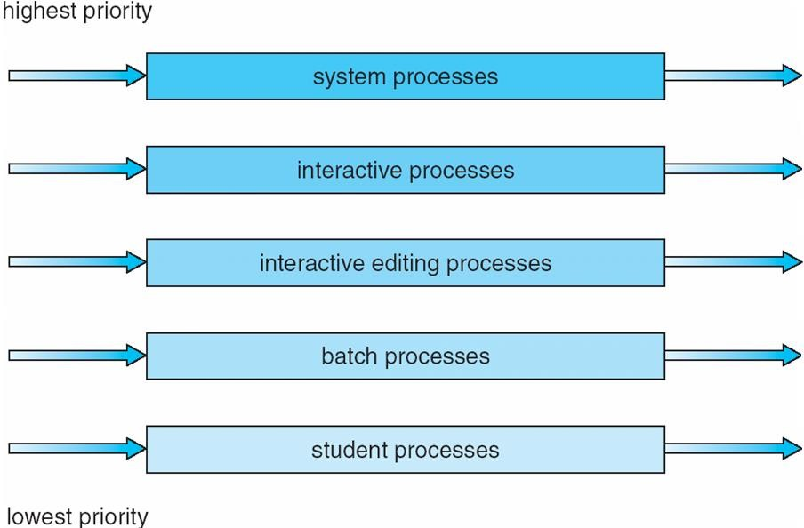
Multilevel Queue Scheduling
Operating System Concepts – 8th Edition

Slide 39
Multilevel Feedback Queue
A process can move between the various queues; aging can
be implemented this way
Multilevel-feedback-queue scheduler defined by the following parameters:
number of queues
scheduling algorithms for each queue
method used to determine when to upgrade a process
method used to determine when to demote a process
method used to determine which queue a process will enter when that process needs service
Operating System Concepts – 8th Edition

Slide 40
Example of Multilevel Feedback Queue
Three queues:
Q₀ – RR with time quantum 8 milliseconds
Q₁ – RR time quantum 16 milliseconds
Q₂ – FCFS
Scheduling
A new job enters queue Q₀ which is served FCFS. When it gains CPU, job receives 8 milliseconds. If it does not finish in 8 milliseconds, job is moved to queue Q₁.
At Q₁ job is again served FCFS and receives 16 additional milliseconds. If it still does not complete, it is preempted and moved to queue Q₂.
Operating System Concepts – 8th Edition

Slide 41
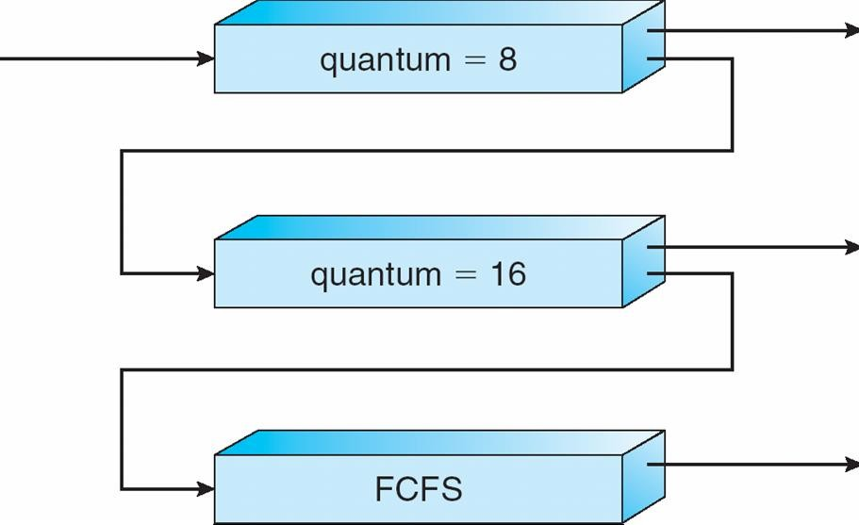
Multilevel Feedback Queues
Operating System Concepts – 8th Edition

